Slide 1
^{@SDFlies #BGSOrientation}
Today’s program:
Doing Research Responsibly — Steve, ~25min
  Theme: Starting your Professional Life with Rigor
Laboratory Notebook — Steve, ~ 20min
Kate, Chelsea & Ben, ~ 40min total
  Theme: organize, Organize, ORGANIZE!
Set up an Electronic Notebook — LabArchives Breakout session, on ZOOM: ~50min https://labarchives.zoom.us/j/96412599295?pwd=elIzMmM3WEZmVjlmckFNZjVMNDNhQT09
Meeting ID: 964 1259 9295; Passcode: 808862
Notes:
What are your goals? Give me some words…
Do Good science
Recognize good science
Help Others – Kelly talked about this a lot from the POV of you getting from others –remember that you guide others, too
You are creating your professional self.

Slide 2
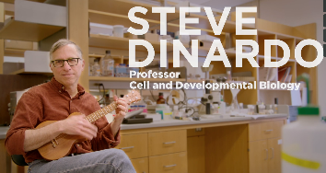
responsible conduct of research (RCR)
Biomedical Graduate Studies
Steve DiNardo
Director, Training Support and Career Development, BGS
^{@SDFlies #BGSOrientation}
Notes:
I will frame today’s topic around YOUR goals.

Slide 3
What is YOUR PRIMARY GOAL?
pause
DO GOOD SCIENCE —
KNOW HOW TO IDENTIFY GOOD SCIENCE —
HELP OTHERS IDENTIFY AND DO GOOD SCIENCE —
All, as you CREATE YOUR ‘PROFESSIONAL SELF’!
Notes:
What are your goals? Give me some words…
Do Good science
Recognize good science
Help Others – Kelly talked about this a lot from the POV of you getting from others –remember that you guide others, too
You are creating your professional self.

Slide 4
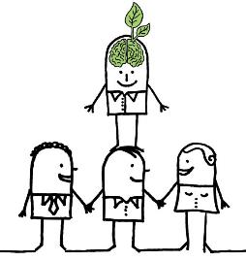
What is YOUR PRIMARY GOAL?
TO DO GOOD SCIENCE —
Must stand on the shoulders of others who came before
MUST IDENTIFY GOOD SCIENCE —
How to pick the right shoulders?
The science that came before was done:
Responsibly
Reproducibly
& with Rigor!
RCR training provides you with tools.
https://blog.yorksj.ac.uk/moodle/files/2014/05/LAWW.jpg
Notes:
Requires that the science that came before is done Responsibly
Reproducibly
& with Rigor.

Slide 5
What is YOUR PRIMARY GOAL?
DO GOOD SCIENCE —
Standing on the shoulders of others who came before:
BY CREATING YOUR ‘PROFESSIONAL SELF’:
You become those shoulders to stand on!
You are here
The science you do must be done:
Responsibly
Reproducibly
& with Rigor!
Notes:
Requires that the science that came before is done Responsibly
Reproducibly
& with Rigor.

Slide 6
What Essential QUALITIES
SHOULD YOU strive for?
HONESTY — conveying information truthfully and honoring commitments
ACCURACY— reporting findings precisely and taking care to avoid errors
EFFICIENCY— using resources wisely and avoiding waste, and
OBJECTIVITY— letting the facts speak for themselves and avoiding improper bias.

Slide 7
responsibly conduct research (RCR)
THOSE are the
QUALITIES needed to:
THE IDEAS ARE NOT DIFFICULT TO FATHOM;
BUT THEY NEED TO BE MADE EXPLICIT
Notes:
Those qualities allow you to conduct research responsibly.
Responsible to whom?
Yourself
Peers / Colleagues
Profession
Society

Slide 8
areas that require
‘Responsible Conduct’
Laboratory Notebooks
Acquisition and Management of Data
Collaborative Science
Conflicts of Interest and Time
Mentoring
Peer Review
Research Misconduct
Responsible Authorship and Publication
Scientists as Responsible Members
of Society
Use of Animals in Research
Use of Humans in Research
Rigor in Experiment Design
ETHICAL QUESTIONS
CAN WILL ARISE
IN THESE
SUBJECT AREAS

Slide 9
Training in RCR
Your training in RCR is continual.
Why?
See concepts several times; In different contexts
= they are “sticky”!
  On-line instruction in Years 1–4 (‘Knowledgelink’)
  Workshops based on ‘Case Studies’ in Years 2–4
  RCR-focused lab meetings in Years 3–5
Notes:
So, with regard to the nuts and bolts of training, know first that NIH requires training of us and other biomedical institutions in RCR.
We meet the requirements through …
This is another of Kelly’ s examples of, “You will see this several times, in several contexts.
It must be important.
Oh, I see now why (else) its important (because you are ready for it in another context)

Slide 10
Case Studies
You will read ‘Case Studies’ often
These are a source for discussion
In small groups to promote comfortable discussion
Each group has a ‘facilitator’
  One who guides, not lectures
  (for some topics) there will be no perfect answer
You had a great intro to Case Studies yesterday ”On Mentorship’
Notes:
We use case studies *a lot*.

Slide 11

Apply those Essential QUALITIES in considering case studies
HONESTY — conveying information truthfully and honoring commitments
ACCURACY— reporting findings precisely and taking care to avoid errors
EFFICIENCY— using resources wisely and avoiding waste, and
OBJECTIVITY— letting the facts speak for themselves and avoiding improper bias.

Slide 12
Example Case Study
Mike is a 4th-year student. His work is progressing well, however some data aren’t falling into place.
Specifically a few control experiments he knows should work are not working.
He doesn’t want to bother his thesis advisor or thesis committee with what he thinks is a minor detail, so he has not asked for advice or help.
(continued)
Notes:
Let’s start with a case study.
This one deals with Mike, a graduate student. We have others that deal with staff, postdocs, faculty.
A control is a validation that your basic experimental assumptions are correct.
How are we feeling about Mike at this point, with regard to the core elements we outlined?
What should we do if we were to counsel him?
(Kelly): seek the advice of others.

Slide 13
Case Study, Continued
Perhaps because he expects them to work soon, or because he does not want to ruin what’s really a pretty nice story, Mike, when asked about the controls at a lab meeting says, “…no worries, I’ve done them; they were as expected”.
How do you rate Mike?
(Honesty, Accuracy, Efficiency, Objectivity)
(continued)
pause
Notes:
How are we feeling now?? So let’s think about that.

Slide 14
Case Study, Continued
His advisor is happy that everything is in place, and asks that the experiments be included in a poster Mike is preparing for a meeting.
Mike does so, without the – nonexistent – controls.
At the meeting, Mike intentionally steers discussion at his poster away from any consideration of controls.
And, now? Honesty, Accuracy, Efficiency, Objectivity
(continued)
pause

Slide 15
Case Study, Continued
When Mike returns to lab, he finds that his advisor has incorporated his data into a manuscript just submitted to a journal, with the controls mentioned in the text.
We’ve focused on Mike …
What about his PI? What is/was their role?
pause
Notes:
-Mike fesses up at this point, the advisor contacts the editorial staff to retract the article from review.
We’ve focused on the student, BUT .. .
Does the advisor come out of this case study unscathed?
Breakdown. Obviously with serious consequences.

Slide 16
Which area(s) does this case study highlight?
Acquisition and Management of Data
Collaborative Science
Conflicts of Interest and Time
Mentoring
Peer Review
Research Misconduct
Responsible Authorship and Publication
Scientists as Responsible Members
of Society
Use of Animals in Research
Use of Humans in Research
Notes:
research misconduct
In presenting it, but also in skewing conversations that occurred.

Slide 17
Research Misconduct
A definition:
Fabrication, falsification, plagiarism, or other serious deviation from accepted practices in…”
  Proposing
  Performing
  Reviewing
  Reporting
  …research or research results.
Notes:
It’s all about misrepresentation in any setting

Slide 18

The goal of your RCR training:
Acquisition and Management of Data
Collaborative Science
Conflicts of Interest and Time
Mentoring
Peer Review
Research Misconduct
Responsible Authorship and Publication
Scientists as Responsible Members
of Society
Use of Animals in Research
Use of Humans in Research
Provide you with
tools to
anticipate matters
arising in these areas
Notes:
Research misconduct aside, there’s not a week that goes by that I don’t think about each of these in some fashion or another.

Slide 19
RCR will be continual during your time here
  On-line instruction in Years 1–4 (‘Knowledgelink’)
  Workshops based on Case studies in Years 2–4
    Year 2: Research misconduct and data management
    Year 3: Mentor/mentee relationships, collaborative
    science, animal and human subjects
    Year 4: Conflict of interest, responsible authorship/
    publication, peer review
  RCR-focused lab meetings in Years 3–5
BGS has a phenomenal Resource for you
Notes:
Manning’s wonderful stuff!

Slide 20
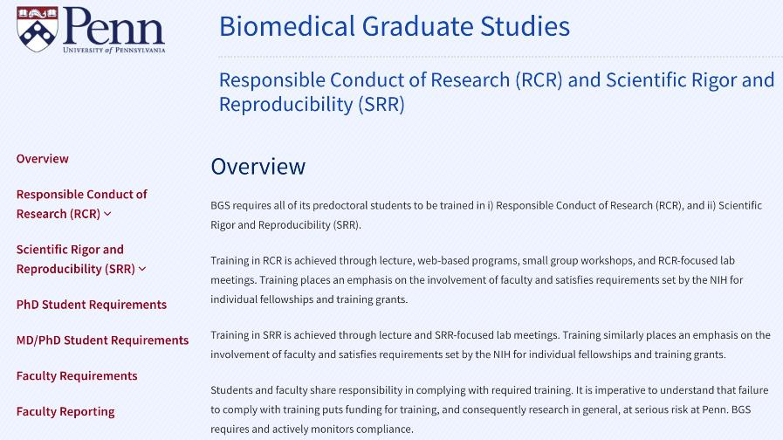
BGS RCR/SRR Website

Slide 21
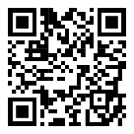
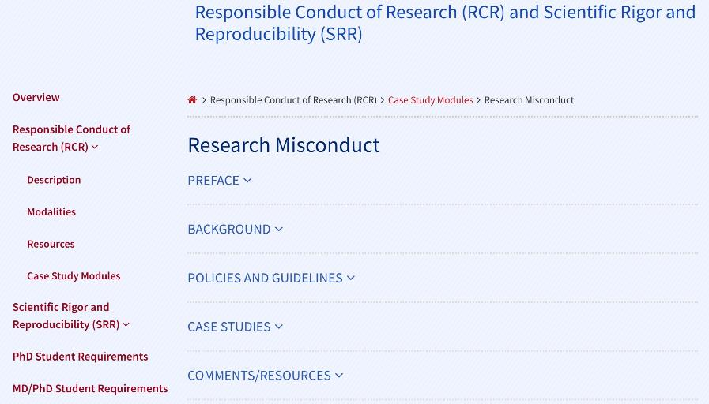
BGS RCR/SRR Website http://bit.ly/BGS_RCR_UPENN

Slide 22
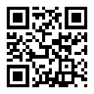
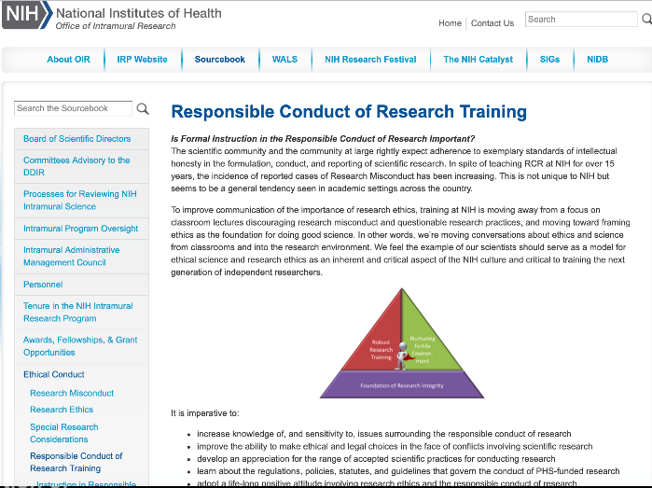
NIH RCR Resources http://bit.ly/NIH_RCR

Slide 23
To Sum up: these ARE your QUALITIES
HONESTY — conveying information truthfully and honoring commitments,
ACCURACY— reporting findings precisely and taking care to avoid errors,
EFFICIENCY— using resources wisely and avoiding waste, and
OBJECTIVITY— letting the facts speak for themselves and avoiding improper bias.
Notes:
You are in control of your work. Apply the above to your work. Must consider all areas of your ‘reach’. Must actively think about these.

Slide 24
What is YOUR PRIMARY GOAL?
CREATING YOUR ‘PROFESSIONAL SELF’:
Be the right shoulders to stand on!
Be here
By carrying out your science:
Responsibly
Reproducibly
& with Rigor!
Notes:
Requires that the science that came before is done Responsibly
Reproducibly
& with Rigor.

Slide 25
Training in Scientific Rigor and Reproducibility (SRR)
SRR is related to the ethical conduct of research (RCR).
Rigorous Experimental Design; Authenticate Reagents;
Transparency in your Protocols.
Your training in SRR will:
  Be continuous
  Use complementary mechanisms (different ‘Contexts’):
    BGS Courses (Year 1 & beyond): integrated within courses
    Workshop (Year 2): ‘Resource & Reagent Authentication’
    Candidacy exam (Year 2); expected throughout your proposal
    Experimental design-focused lab meetings (Years 3- 5)
**Thursday, 8/27 Kurt Engleka: Ready, Set, Experiment!
Notes:
Very closely related to RCR training is training in what’s referred to as Rigorous Experimental Design and Transparency to Enhance Reproducibility

Slide 26
^{@SDFlies #BGSOrientation}
Today’s program:
Doing Research Responsibly — Steve, ~25min
  Theme: Starting your Professional Life with Rigor
Laboratory Notebook — Steve, ~ 20min
Kate, Chelsea & Ben, ~ 40min total
  Theme: organize, Organize, ORGANIZE!
Set up an Electronic Notebook — LabArchives Breakout session, on ZOOM: ~50min https://labarchives.zoom.us/j/96412599295?pwd=elIzMmM3WEZmVjlmckFNZjVMNDNhQT09
Meeting ID: 964 1259 9295; Passcode: 808862

